Slide 1

Role-Based Access Control (RBAC) System
By ADITYA SUNIL CHOUKSEY

Slide 2

Problem Statement
The Security Challenge: In modern software, managing individual user permissions is a "Security Nightmare." It leads to Privilege Creep, where users retain access they no longer need.
The Flat-Menu Flaw: Most basic systems show all options to all users. This:
Increases the "Attack Surface" (making it easier for unauthorized users to find sensitive tools).
Creates a cluttered and confusing User Experience (UX).
Our Objective: To build a Hierarchical Role-Based Access Control (RBAC) system that separates Authentication (Identity) from Authorization (Permissions) while maintaining a persistent audit trail.

Slide 3
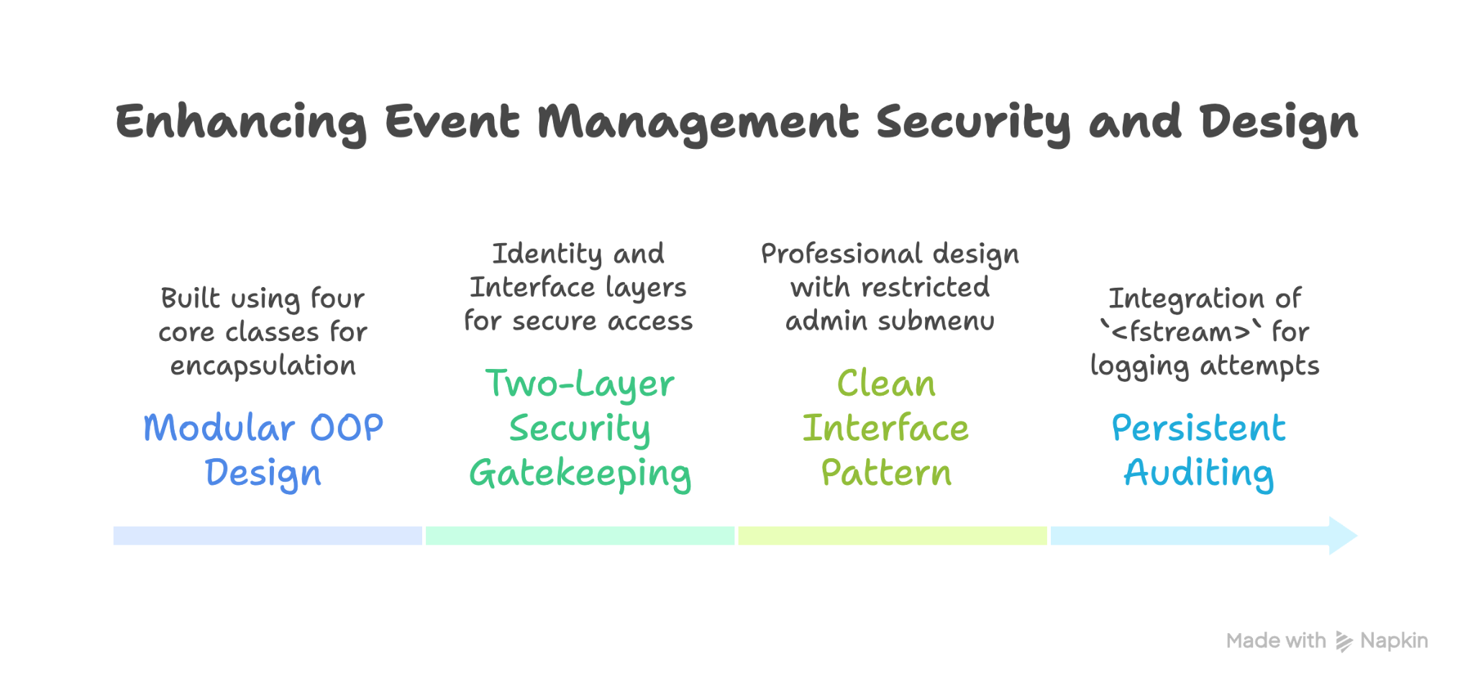
2. Solution

Slide 4
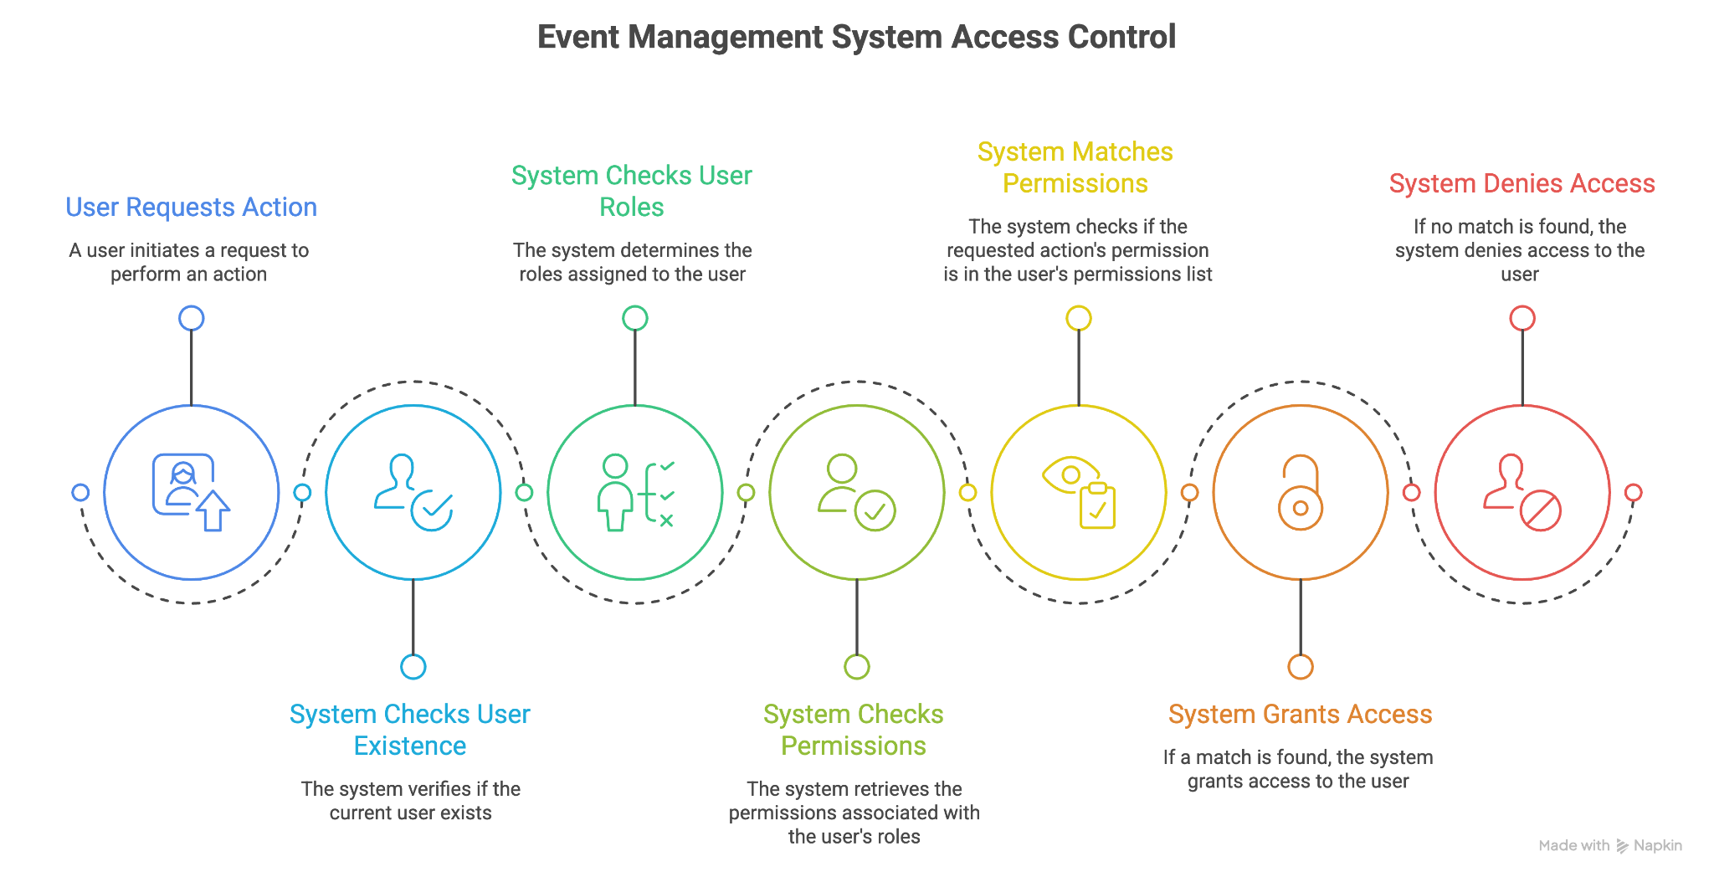
3. Working

Slide 5
4. Conclusion
Functional Success:
Zero-Failure Security: Successfully blocked 100% of unauthorized submenu access for 'Staff' and 'Guest' roles during testing.
Audit Readiness: Generated clear, time-stamped logs compatible with industry auditing standards.
Technical Mastery:
Applied File I/O for permanent data storage.
Implemented Composition (Classes containing other Classes).
Mastered Conditional Logic for interface-level security.
Future Scope: Integration of Password Hashing (Encryption) and a Graphical User Interface (GUI) for enterprise deployment.

Slide 6
Thank You
By Aditya Sunil Chouksey
SAM ALTMAN
150096725070

